Slide 1
Congestion Control
Module 5

Slide 2
DATA TRAFFIC
In congestion control we try to avoid traffic congestion.
Traffic Descriptor: Traffic descriptors are qualitative values that represent a data flow.
Traffic Profiles

Slide 3
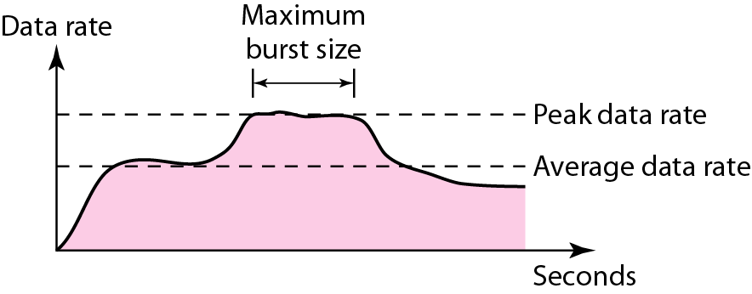
Figure Traffic descriptors

Slide 4
Traffic Descriptor
Average Data Rate:
number of bits sent during a period of time, divided by the number of seconds in that period.
it indicates the average bandwidth needed by the traffic.
Peak Data Rate:
defines the maximum data rate of the traffic.
indicates the peak bandwidth that the network needs for traffic to pass through without changing its data flow.
Maximum Burst Size: maximum burst size normally refers to the maximum length of time the traffic is generated at the peak rate.
Effective Bandwidth:
bandwidth that the network needs to allocate for the flow of traffic.
The effective bandwidth is a function of three values: average data rate, peak data rate, and maximum burst size.

Slide 5
Traffic Profiles
Constant Bit Rate:
has a data rate that does not change.
the average data rate and the peak data rate are the same.
easy for a network to handle since it is predictable.
Variable Bit Rate:
the rate of the data flow changes in time, with the changes smooth instead of sudden and sharp.
the average data rate and the peak data rate are different. The maximum burst size is usually a small value.
normally does not need to be reshaped.
Bursty:
the data rate changes suddenly in a very short time.
It may jump from zero, for example, to 1 Mbps in a few microseconds and vice versa.
average bit rate and the peak bit rate are very different values in this type of flow. The maximum burst size is significant.
most difficult type of traffic for a network to handle.
normally needs to reshape it, using reshaping techniques.
main causes of congestion in a network.

Slide 6
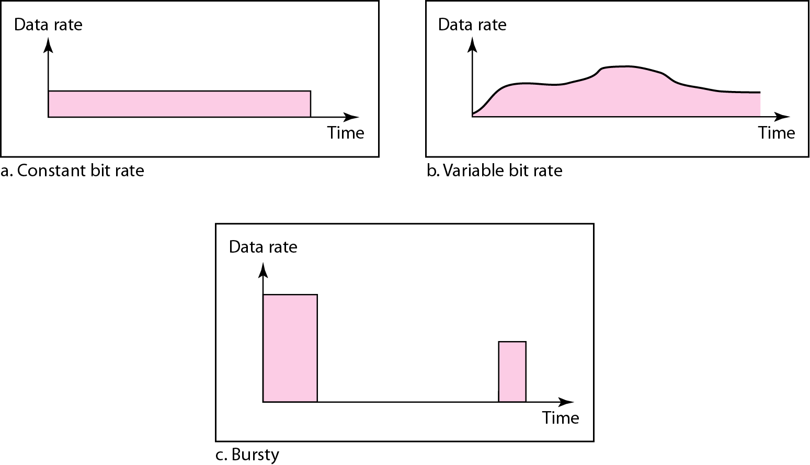
Figure Three traffic profiles

Slide 7
What Is Congestion?
congestion occurs when the no of packets being transmitted through the network approaches the packet handling capacity of the network
congestion control aims to keep no of packets below a level at which performance falls off dramatically
a data network is a network of queues
generally 80% utilization is critical
Notes:
Congestion occurs when the number of packets being transmitted through a network begins to approach the packet-handling capacity of the network. The objective of congestion control is to maintain the number of packets within the network below the level at which performance falls off dramatically.
A data network or internet is a network of queues. At each node (data network switch, internet router), there is a queue of packets for each outgoing channel. If the rate at which packets arrive and queue up exceeds the rate at which packets can be transmitted, the queue size grows without bound and the delay experienced by a packet goes to infinity. Even if the packet arrival rate is less than the packet transmission rate, queue length will grow dramatically as the arrival rate approaches the transmission rate. As a rule of thumb, when the line for which packets are queuing becomes more than 80% utilized, the queue length grows at an alarming rate. This growth in queue length means that the delay experienced by a packet at each node increases. Further, since the size of any queue is finite, as queue length grows, eventually the queue must overflow.

Slide 8
CONGESTION
important issue in a packet-switched network is congestion.
may occur if the load on the network-the number of packets sent to the network-is greater than the capacity of the network-the number of packets a network can handle.
Congestion control refers to the mechanisms and techniques to control the congestion and keep the load below the capacity.

Slide 9
CONGESTION
Congestion happens in any system that involves waiting.
For example, an accident on a road during rush hour, creates blockage.
Congestion in a network or internetwork occurs because routers and switches have queues-buffers that hold the packets before and after processing.

Slide 10
CONGESTION
A router, for example, has an input queue and an output queue for each interface.
When a packet arrives at the incoming interface, it undergoes three steps before departing:
1. The packet is put at the end of the input queue while waiting to be checked.
2. The processing module of the router removes the packet from the input queue once it reaches the front of the queue and uses its routing table and the destination address to find the route.
3. The packet is put in the appropriate output queue and waits its tum to be sent

Slide 11
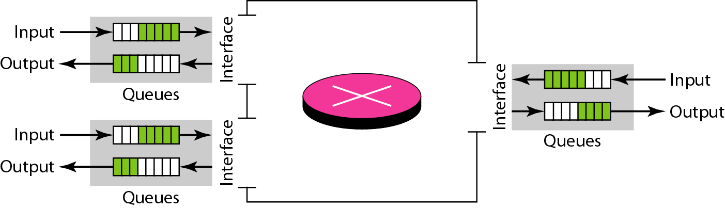
Figure Queues in a router

Slide 12
CONGESTION
Network Performance:
Congestion control involves two factors that measure the performance of a network: delay and throughput.
Delay Versus Load:
load is much less than the capacity of the network, the delay is at a minimum.
This minimum delay is composed of propagation delay and processing delay, both of which are negligible.
when the load reaches the network capacity, the delay increases sharply because we now need to add the waiting time in the queues (for all routers in the path) to the total delay.
size of the queues
When a packet is delayed, the source, not receiving th acknowledgment, retransmits the packet, which makes the delay, and the congestion, worse.

Slide 13
CONGESTION
Network Performance:
Throughput Versus Load:
Throughput: the number of packets passing through the network in a unit of time.
when the load is below the capacity of the network, the throughput increases proportionally with the load.
after the load reaches the capacity, but instead the throughput declines sharply.
reason is the discarding of packets by the routers.
When the load exceeds the capacity, the queues become full and the routers have to discard some packets.
Discarding packets does not reduce the number of packets in the network because the sources retransmit the packets, using time-out mechanisms, when the packets do not reach the destinations.

Slide 14
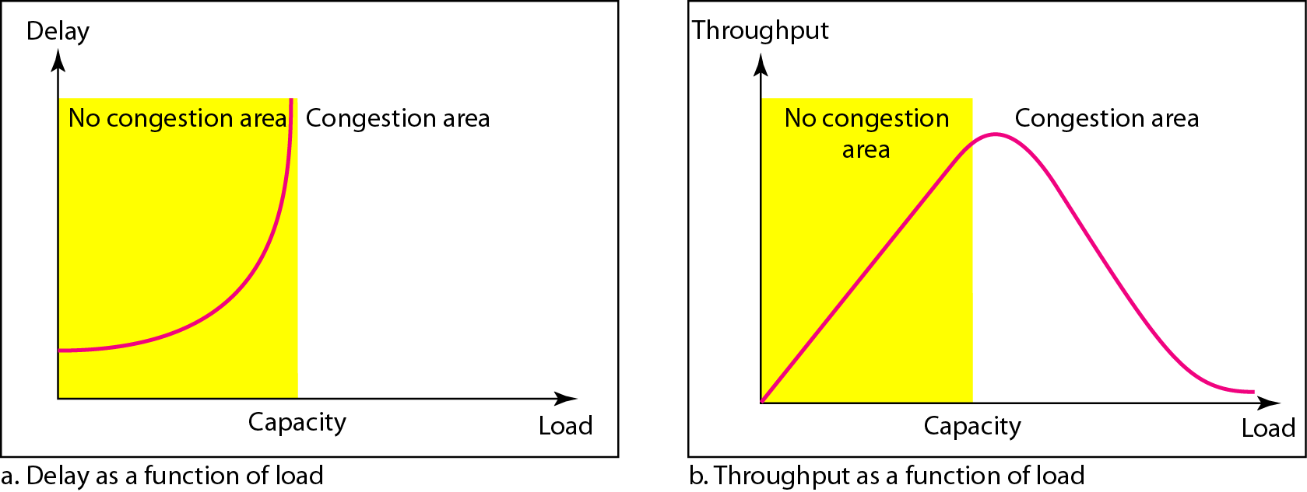
Figure Packet delay and throughput as functions of load

Slide 15
CONGESTION CONTROL
Congestion control refers to techniques and mechanisms that can either prevent congestion, before it happens, or remove congestion, after it has happened. In general, we can divide congestion control mechanisms into two broad categories: open-loop congestion control (prevention) and closed-loop congestion control (removal).
Topics discussed in this section:
Open-Loop Congestion Control Closed-Loop Congestion Control

Slide 16
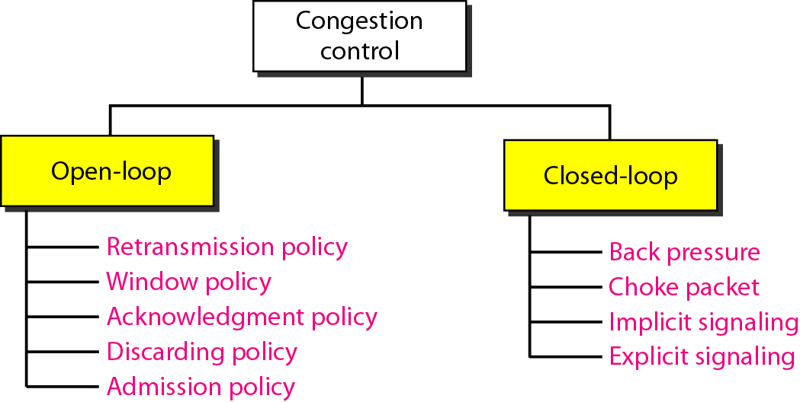
Figure Congestion control categories

Slide 17
CONGESTION CONTROL
Open-Loop Congestion Control
Retransmission Policy
The retransmission policy and the retransmission timers must be designed
to optimize efficiency and at the same time prevent congestion.
Window Policy : Eg. Selective repeat window/ go back N window
Acknowledgment Policy
We need to know that the acknowledgments are also part of the load in a network. Sending fewer acknowledgments means imposing less load on the network.
Discarding Policy
Admission Policy
is a quality-of-service mechanism, can also prevent congestion in virtual-circuit networks. Switches in a flow first check the resource requirement of a flow before admitting it to the network. A router can deny establishing a virtual circuit connection if there is congestion in the network or if there is a possibility of future congestion.

Slide 18
CONGESTION CONTROL
Closed-Loop Congestion Control
Backpressure:
A congested node stops receiving data from the immediate upstream node or nodes.
This may cause the upstream node or nodes to become congested, and they, in turn, reject data from their upstream nodes or nodes. And so on.
node-to-node congestion control that starts with a node and propagates, in the opposite direction of data flow, to the source.
The backpressure technique can be applied only to virtual circuit networks, in which each node knows the upstream node from which a flow of data is coming.
Eg. Was implemented in X.25.

Slide 19
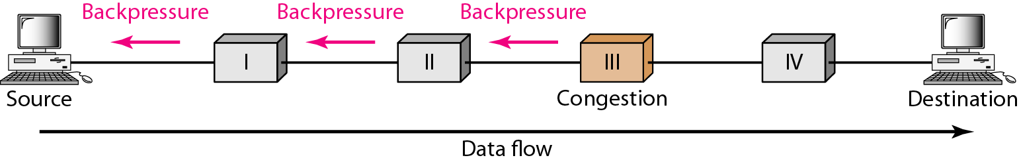
Figure Backpressure method for alleviating congestion

Slide 20
CONGESTION CONTROL
Closed-Loop Congestion Control
Choke Packet
A choke packet is a packet sent by a node to the source to inform it of congestion.
In the choke packet method, the warning is from the router, which has encountered congestion, to the source station directly.
for example. source quench ICMP(Internet Control Message Protocol) message

Slide 21
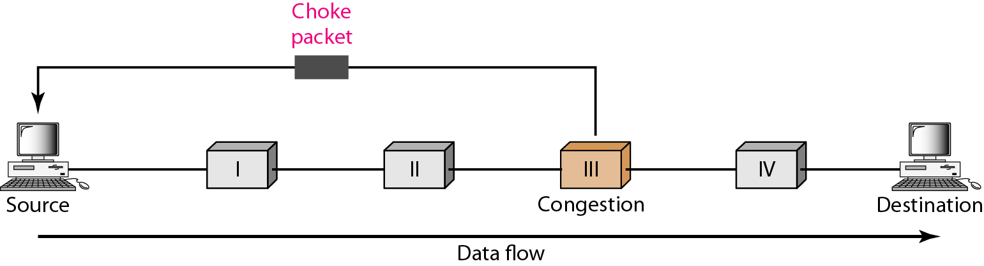
Figure Choke packet

Slide 22
CONGESTION CONTROL
Closed-Loop Congestion Control
Implicit Signaling
no communication between the congested node or nodes and the source.
source guesses that there is a congestion somewhere in the network from other symptoms.
The delay in receiving an acknowledgment is interpreted as congestion in the network; the source should slow down. Eg. TCP

Slide 23
CONGESTION CONTROL
Closed-Loop Congestion Control
Explicit Signaling
The node that experiences congestion can explicitly send a signal to the source or destination. In the choke packet method, a separate packet is used for this purpose; In the explicit signaling method, the signal is included in the packets that carry data. Eg Frame Relay congestion control.
Backward Signaling: A bit can be set in a packet moving in the direction opposite to the congestion. This bit can warn the source that there is congestion and that it needs to slow down to avoid the discarding of packets.
Forward Signaling: A bit can be set in a packet moving in the direction of the congestion. This bit can warn the destination that there is congestion. The receiver in this case can use policies, such as slowing down the acknowledgments, to alleviate the congestion.

Slide 24
Congestion Control in Frame Relay
Frame Relay network has the potential to be really congested with traffic:
A high throughput and low delay are the main goals of the Frame Relay protocol.
does not have flow control.
allows the user to transmit bursty data.

Slide 25
Congestion Control in Frame Relay
Congestion Avoidance:
uses 2 bits in the frame to explicitly
warn the source and the destination of the presence of congestion.
The backward explicit congestion notification (BECN) bit
The switch can use response frames from the receiver (full-duplex mode), or else the switch can use a predefined connection (DLCI =1023) to send special frames for this specific purpose.
The sender can respond to this warning by simply reducing the data rate.

Slide 26
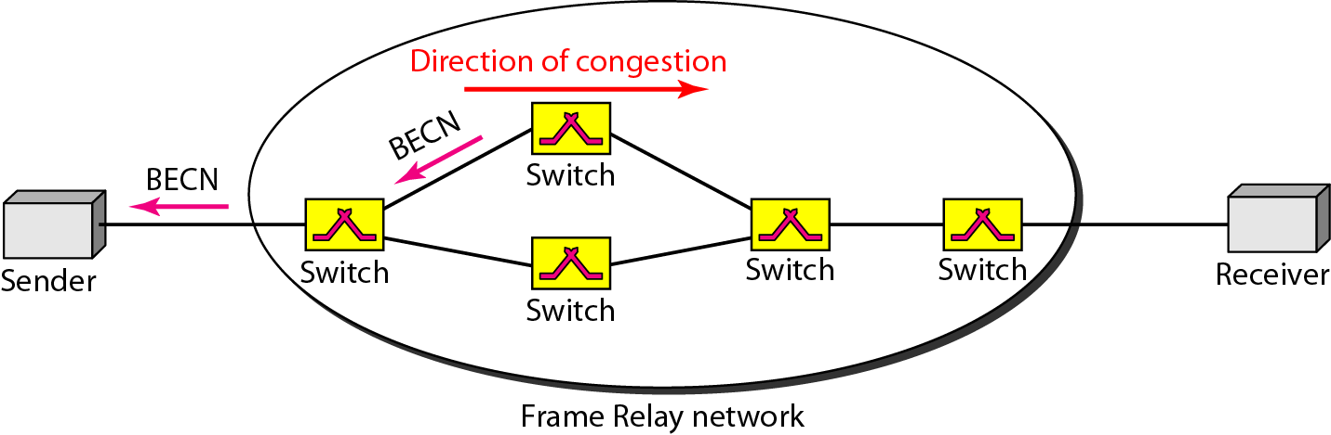
Figure BECN

Slide 27
Congestion Control in Frame Relay
Congestion Avoidance:
uses 2 bits in the frame to explicitly
warn the source and the destination of the presence of congestion.
The forward explicit congestion notification (FECN) bit
The Frame Relay protocol assumes that the sender and receiver are communicating with each other and are using some type of flow control at a higher level.

Slide 28
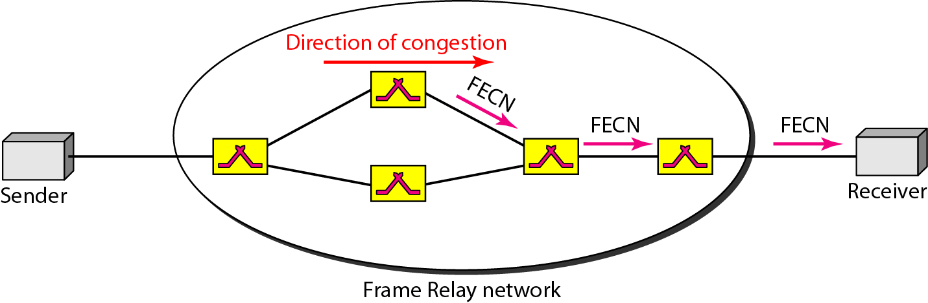
Figure FECN

Slide 29
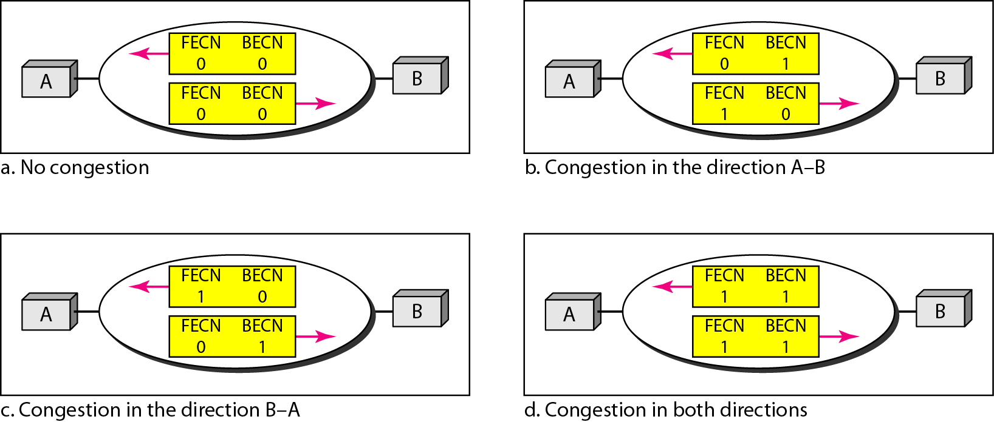
Figure Four cases of congestion

